Slide 1
Theory of Automata
Kleen’s Theorem
Dr Aftab Maroof
Adeel Ashraf Cheema
Faryal Saud

Slide 2
Contents
Unification
Turning TGs into Regular Expressions
Converting Regular Expressions into FAs
Nondeterministic Finite Automata
NFAs and Kleene’s Theorem
Theory of Automata

Slide 3
Unification
We have learned three separate ways to define a language: (i) by regular expression, (ii) by finite automaton, and (iii) by transition graph.
Now, we will present a theorem proved by Kleene in 1956, which says that if a language can be defined by any one of these three ways, then it can also be defined by the other two.
In other words, Kleene proved that all three of these methods of defining languages are equivalent.
Theory of Automata

Slide 4
Theorem 6 - Kleene’s Theorem
Any language that can be defined by regular expression, or finite automaton, or transition graph can be defined by all three methods.
Theory of Automata

Slide 5
Kleene’s Theorem
This theorem is the most important and fundamental result in the theory of finite automata.
We will take extreme care with its proofs. In particular, we will introduce four algorithms that enable us to construct the corresponding machines and expressions.
Recall that
  – To prove A = B, we need to prove (i) A ⊂ B, and (ii) B ⊂ A.
  – To prove A = B = C, we need to prove (i) A ⊂ B, (ii) B ⊂ C, and (iii) C ⊂ A.
Theory of Automata

Slide 6
Kleene’s Theorem
Thus, to prove Kleene’s theorem, we need to prove 3 parts:
Part 1: Every language that can be defined by a finite automaton can also be defined by a transition graph.
Part 2: Every language that can be defined by a transition graph can also be defined by a regular expression.
Part 3: Every language that can be defined by a regular expression can also be defined by a finite automaton.
Theory of Automata

Slide 7
Proof of Part 1
This is the easiest part.
From previous lecture, we know that every finite automaton is itself already a transition graph. Therefore, any language that has been defined by a finite automaton has already been defined by a transition graph.
Theory of Automata

Slide 8
Turning TGs into Regular Expressions
Theory of Automata

Slide 9
Proof of Part 2: Turning TGs into Regular Expressions
We prove this part by providing a constructive algorithm:
    – We present an algorithm that starts out with a transition graph and ends up with a regular expression that defines the same language.
    – To be acceptable as a method of proof, the algorithm we present will satisfy two criteria:
      It works for every conceivable TG, and
      It guarantees to finish its job in a finite number of steps.
Slides 10 - 30 below present the proof of part 2.
Theory of Automata

Slide 10
Step-1 Creating A Unique Start State
Consider an abstract transition graph T that may have many start states.
We can simplify T so that it has only one unique start state that has no incoming edges.
We do this by introducing a new start state that we label with the minus sign, and that we connect to all the previous start states by edges labeled with Λ. We then drop the minus signs from the previous start states.
If a word w used to be accepted by starting at one of the previous start states, then it can now be accepted by starting at the new unique start state.
The following figure illustrates this idea.
Theory of Automata

Slide 11
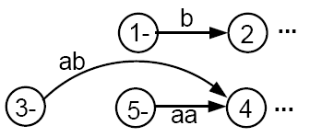
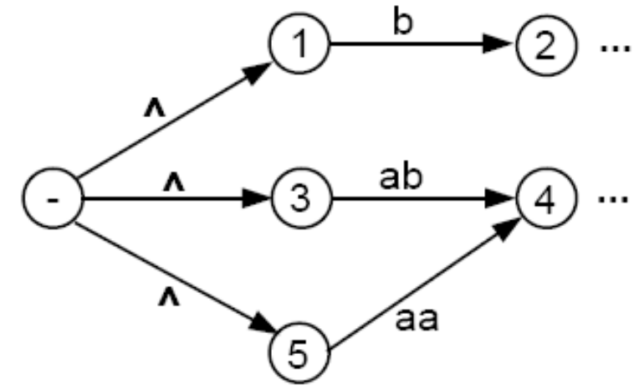
Consider a fragment of T:
The above fragment of T can be replaced by
Theory of Automata

Slide 12
Step 2 - Creating a Unique Final State
Let us make another simplification in T so that it has a unique, un-exitable final state, without changing the language it accepts.
If T had no final state, then it accepts no strings at all and has no language. So, we need to produce no regular expression other than the null, or empty, expression Φ(see page 36 of the text).
If T has several final states, we can introduce a new unique final state labeled with a plus sign. We then draw new edges from all the former final states to the new one, dropping the old plus signs, and labeling each new edge with the null string.
This process is depicted in the next slide.
Theory of Automata

Slide 13
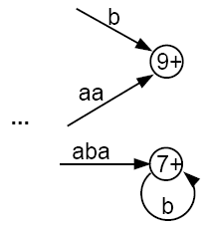
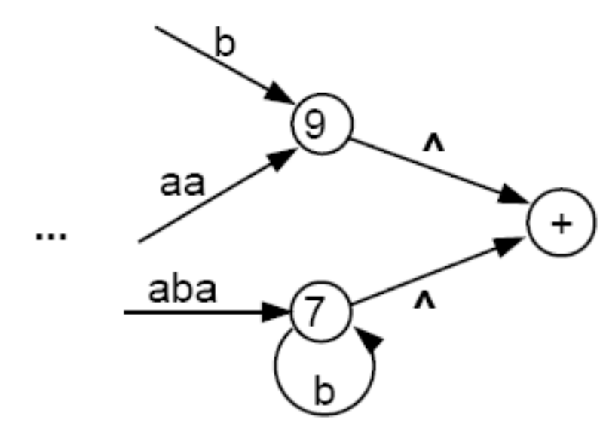
becomes
Theory of Automata

Slide 14
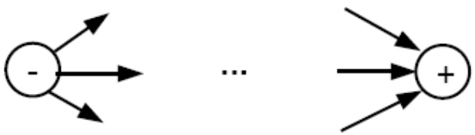
We shall require that the unique final state be a different state from the unique start state. If an old state used to have ±, then both signs are removed from the old state to newly created states, using the processes described above.
It should be clear that the addition of these two new states does not affect the language that T accepts.
The machine now has the following shape:
where there are no other - or + states.
Theory of Automata

Slide 15


Step 3 -- Combining Edges
If T has some internal state x (not the - or the + state) that has more than one loop circling back to itself:
where r₁, r₂, and r₃ are all regular expressions or simple strings.
We can replace the three loops by one loop labeled with a regular expression:
Theory of Automata

Slide 16
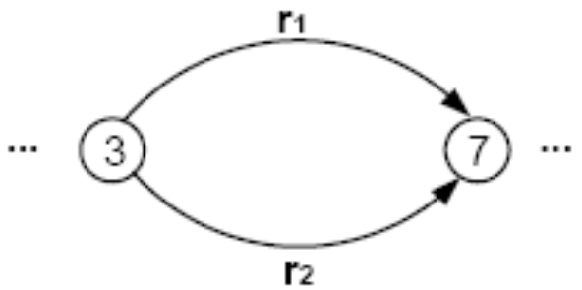

Combining Edges
Similarly, if two states are connected by more than one edge going in the same direction:
We can replace this with a single edge labeled with a regular expression:
Theory of Automata

Slide 17

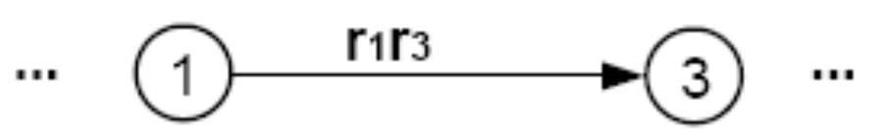
Bypass and State Elimination
If T has 3 states in a row connected by edges labeled with regular expressions or simple strings, we can eliminate the middle state, as in the following examples:
Can be replaced with
Theory of Automata

Slide 18
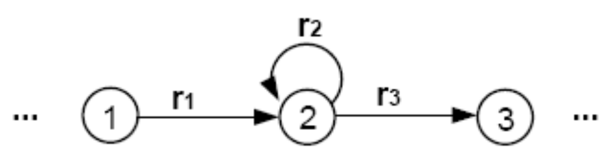

Bypass and State Elimination
If the middle state has a loop, we can proceed as follows:
Can be replaced with
Theory of Automata

Slide 19
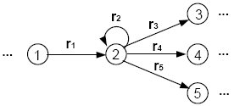
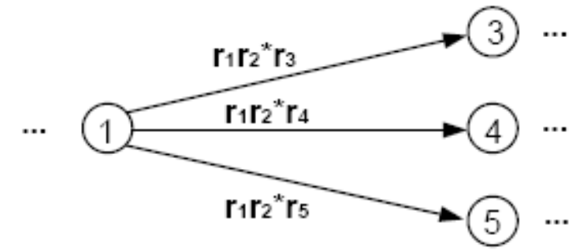
Bypass and State Elimination
If the middle state is connected to more than one state, then the bypass and elimination process can be done as follows:
Can be replaced with
Theory of Automata

Slide 20
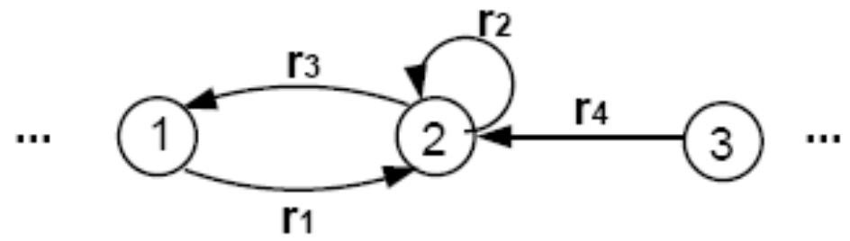
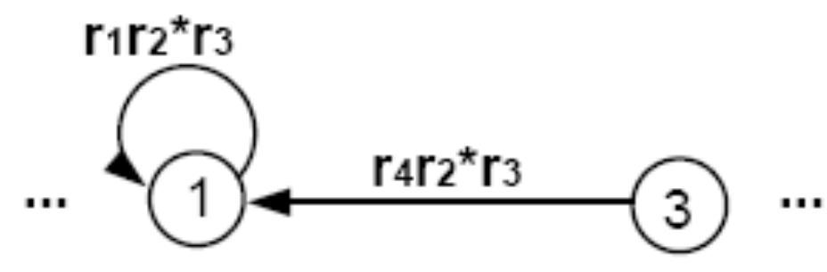
Special Cases
Can be replaced with
Theory of Automata

Slide 21
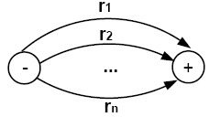
Combining Edges
We can repeat this bypass and elimination process again and again until we have eliminated all the states from T, except for the unique start state and the unique final state. What we come down to is a picture that looks like this:
with each edge labeled by a regular expression.
Theory of Automata

Slide 22
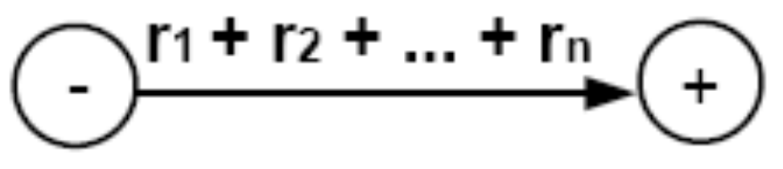
Combing Edges
We can then combine the edges from the above picture one more to produce
in which the resultant expression is the regular expression that defines the same language as T did originally.
Recall that all words accepted by T are paths through the picture of T. If we change the picture but preserve all paths and their labels, we must keep the language unchanged.
Theory of Automata

Slide 23
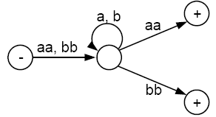
Example
Consider the following TG that accepts all words that begin and end with double letters (having at least length 4):
Theory of Automata

Slide 24
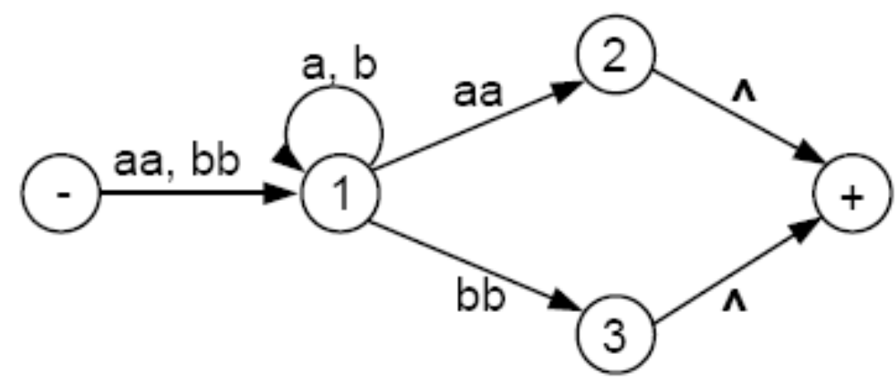
This TG has only one start state with no incoming edges, but has two final states. So, we must introduce a new unique final state:
Theory of Automata

Slide 25
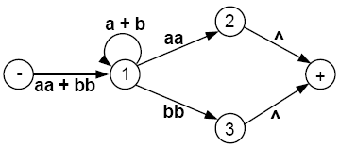
Now we build regular expressions piece by piece:
Theory of Automata

Slide 26
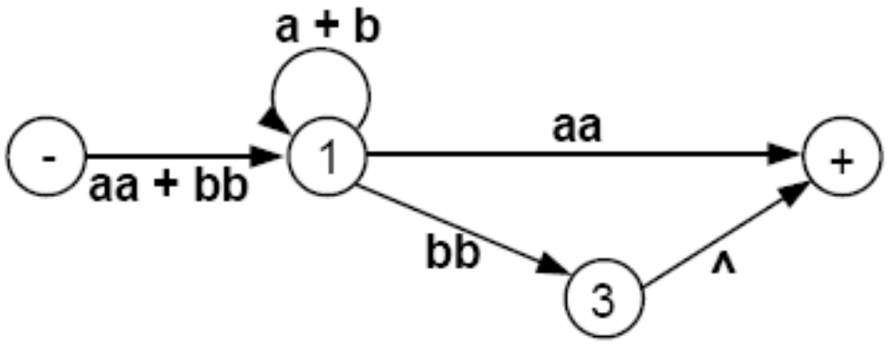
Eliminate state 2:
Theory of Automata

Slide 27
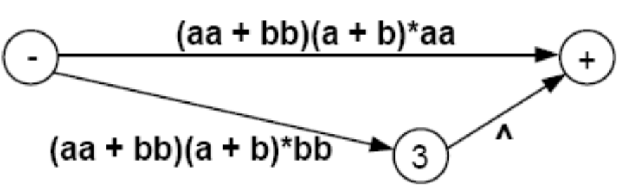
Eliminate state 1:
Theory of Automata

Slide 28
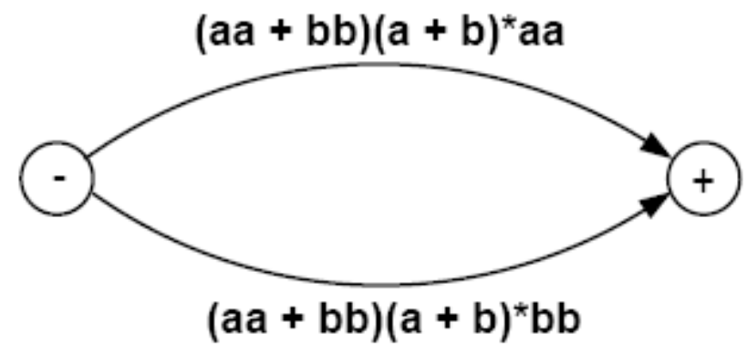
Eliminate state 3:
Theory of Automata

Slide 29
Hence, this TG defines the same language as the regular expression
(aa + bb)(a + b)*(aa) + (aa + bb)(a + b)*(bb)
or equivalently
(aa + bb)(a + b)*(aa + bb)
If we eliminated the states in a different order, we could end up with a different-looking regular expression. But by the logic of the elimination process, these expressions would all have to represent the same language.
We are now ready to present the constructive algorithm that proves that all TGs can be turned into regular expressions that define the exact same language.
Theory of Automata

Slide 30
Algorithm
Step 1: Create a unique, unenterable minus state and a unique, unleaveable plus state.
Step 2: One by one, in any order, bypass and eliminate all the non-minus or non-plus states in the TG. A state is bypassed by connecting each incoming edge with each outgoing edge. The label of each resultant edge is the concatenation of the label on the incoming edge with the label on the loop edge (if there is one) and the label on the outgoing edge.
Step 3: When two states are joined by more than one edge going in the same direction, unify them by adding their labels.
Step 4: Finally, when all that is left is one edge from - to +, the label on that edge is a regular expression that generates the same language as was recognized by the original TG.
Theory of Automata

Slide 31
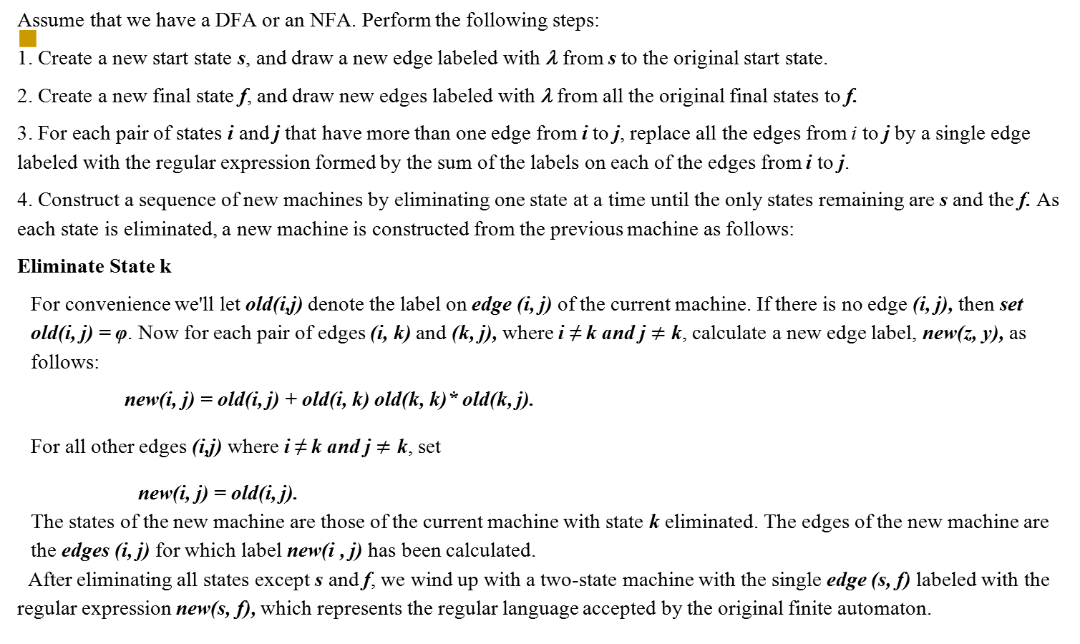
Algorithm for Finite Automaton to Regular Expression Conversion
1a
Theory of Automata

Slide 32
Converting Regular Expressions into FAs
Theory of Automata

Slide 33
Proof of Part 3: Converting Regular Expressions into FAs
We prove this part by recursive definition and constructive algorithm at the same time.
  – We know that every regular expression can be built up from the letters of the alphabet ∑ and Λ by repeated application of certain rules: (i) addition, (ii) concatenation, and (iii) closure.
  – We will show that as we are building up a regular expression, we could at the same time building up an FA that accepts the same language.
Theory of Automata

Slide 34
Before we proceed, let’s have a quick review of the formal definition of regular expressions.
The set of regular expressions is defined by the following rules:
  Rule 1: Every letter of the alphabet ∑ can be made into a regular expression by writing it in boldface: Λ itself is a regular expression.
  Rule 2: If r₁ and r₂ are regular expressions, then so are:
    (r₁)
    r₁r₂
    r₁ + r₂
    r₁*
  Rule 3: Nothing else is a regular expression.
We now present proof of part 3 recursively.
Theory of Automata

Slide 35
Rule 1
There is an FA that accepts any particular letter of the alphabet.
There is an FA that accepts only the word Λ.
Theory of Automata

Slide 36
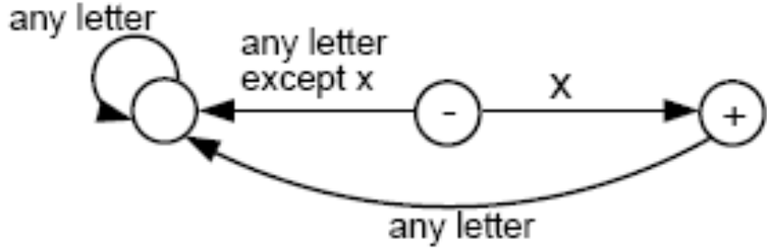
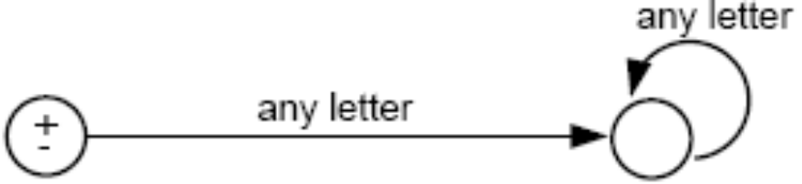
Proof of rule 1
If letter x is in ∑, then the following FA accepts only the word x.
The following FA accepts only λ:
Theory of Automata

Slide 37
Rule 2
If there is an FA called FA₁ that accepts the language defined by the regular expression r₁, and there is an FA called FA₂ that accepts the language defined by the regular expression r₂, then there is an FA that we shall call FA₃ that accepts the language defined by the regular expression (r₁ + r₂).
Theory of Automata

Slide 38
Proof of Rule 2
We shall show that FA₃ exists by presenting an algorithm showing how to construct FA₃.
Algorithm:
  – Starting with two machines, FA₁ with states x₁; x₂; x₃;…, and FA₂ with states y₁; y₂; y₃; …, we construct a new machine FA₃ with states z₁; z₂; z₃; … where each z_{i} is of the form x_{something} or y_{something}.
  – The combination state x_{start} or y_{start} is the start state of the new machine FA₃.
  – If either the x part or the y part is a final state, then the corresponding z is a final state.
Theory of Automata

Slide 39
Algorithm (cont.)
– To go from one state z to another by reading a letter from the input string, we observe what happens to the x part and what happens to the y part and go to the new state z accordingly. We could write this as a formula:
z_{new} after reading letter p = (x_{new} after reading letter p on FA₁) or (y_{new} after reading letter p on FA₂)
Theory of Automata

Slide 40
Remarks
The new machine FA₃ constructed by the above algorithm will simultaneously keep track of where the input would be if it were running on FA₁ alone, and where the input would be if it were running on FA₂ alone.
If a string traces through the new machine FA₃ and ends up at a final state, it means that it would also end at a final state either on machine FA₁ or on machine FA₂. Also, any string accepted by either FA₁ or FA₂ will be accepted by this FA₃. So, the language FA₃ accepts is the union of the languages accepted by FA₁ and FA₂, respectively.
Note that since there are only finitely many states x’s and finitely many states y’s, there can be only finitely many possible states z’s.
Let us look at an example illustrating how the algorithm works.
Theory of Automata

Slide 41
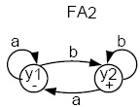
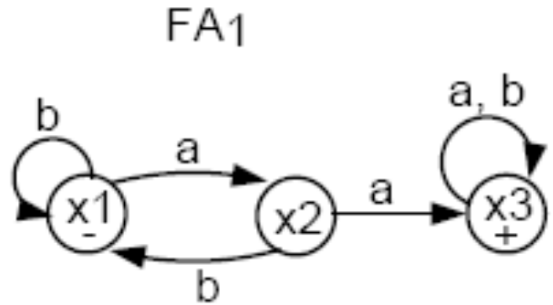
Example
Consider the following two FAs:
FA₁ accepts all words with a double a in them.
FA₂ accepts all words ending with b.
Let’s follow the algorithm to build FA₃ that accepts the union of the two languages.
Theory of Automata

Slide 42
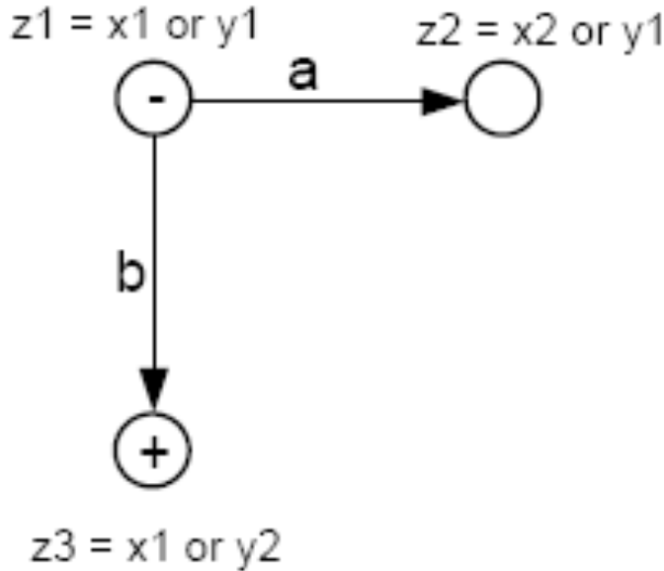
Combining the FAs
The start (-) state of FA₃ is z₁ = x₁ or y₁.
In z₁, if we read an a, we go to x₂ (observing FA₁), or we go to y₁ (observing FA₂).
Let z₂ = x₂ or y₁.
In z₁, if we read a b, we go to x₁ (observing FA₁), or to y₂ (observing FA₂).
Let z₃ = x₁ or y₂. Note that z₃ must be a final state since y₂ is a final state.
Theory of Automata

Slide 43
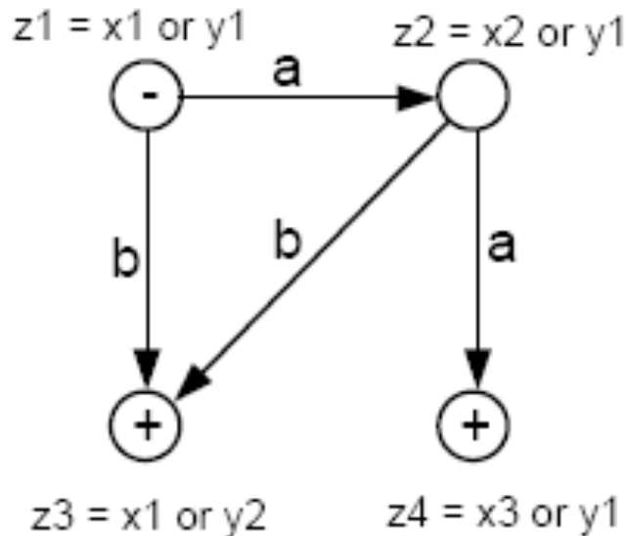
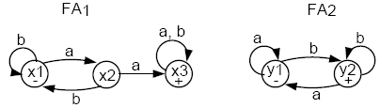
In z₂, if we read an a, we go to x₃ or y₁. Let z₄ = x₃ or y₁. z₄ is a final state because x₃ is.
In z₂, if we read a b, we go to x₁ or y₂, which is z₃.
Theory of Automata

Slide 44
In z₃, if we read an a, we go to x₂ or y₁, which is z₂.
In z₃, if we read a b, we go to x₁ or y₂, which is z₃.
In z₄, if we read an a, we go to x₃ or y₁, which is z₄. Hence, we have an a-loop at z₄.
In z₄, if we read a b, we go to x₃ or y₂. Let z₅ = x₃ or y₂. Note that z₅ is a final state because x₃ (and y₂) are.
In z₅, if we read an a, we go to x₃ or y₁, which is z₄.
In z₅, if we read a b, we go to x₃ or y₂, which is z₅. Hence, there is a b-loop at z₅.
The whole machine looks like the following:
Theory of Automata

Slide 45
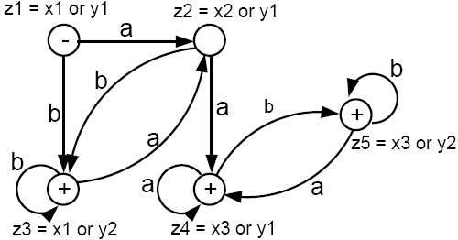
This machine accepts all words that have a double a or that end with b.
The labels z₁ = x₁ or y₁, z₂ = x₂ or y₁, etc. can be removed if you want.
Theory of Automata

Slide 46
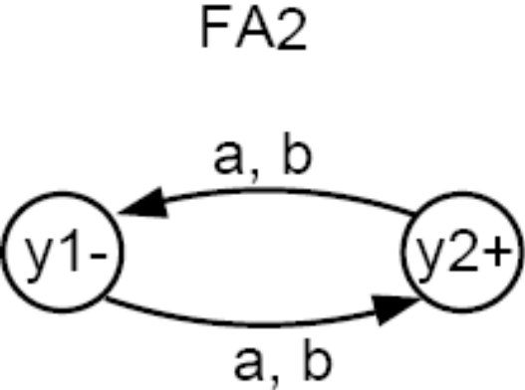
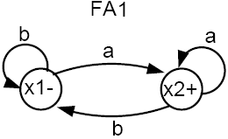
Example
Consider the following two FAs:
FA₁ accepts all words that end in a.
FA₂ accepts all words with an odd number of letters (odd length).
Can you use the algorithm to build a machine FA3 that accepts all words that either have an odd number of letters or end in a?
Theory of Automata

Slide 47
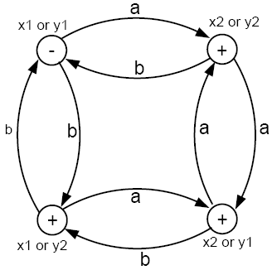
Using the algorithm, we can produce FA₃ that accepts all words that either have an odd number of letters or end in a, as follows:
The only state that is not a + state is the - state. To get back to that start state, a word must have an even number of letters and end in b.
Theory of Automata

Slide 48
Rule 3
If there is an FA₁ that accepts the language defined by the regular expression r₁, and there is an FA₂ that accepts the language defined by the regular expression r₂, then there is an FA₃ that accepts the language defined by the (concatenation) regular expression (r₁r₂), i.e. the product language.
Theory of Automata

Slide 49
We shall show that such an FA₃ exists by presenting an algorithm showing how to construct it from FA₁ and FA₂.
The idea is to construct a machine that starts out like FA₁ and follows along it until it enters a final state at which time an option is reached. Either we continue along FA₁, waiting to reach another +, or else we switch over to the start state of FA₂ and begin circulating there.
Theory of Automata

Slide 50
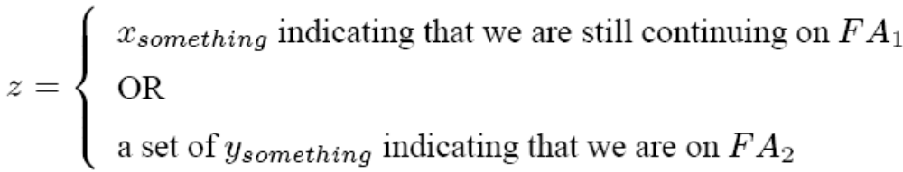
Algorithm
First, create a state z for every state of FA₁ that we may go through before arriving at a final state.
2. For each final state x_{final} of FA₁, add a state z = x_{final} or y₁, where y₁ is the start state of FA₂.
3. From the states added in step 2, add states
4. Label every state z that contains a final state from FA₂ as a final state.
Theory of Automata

Slide 51
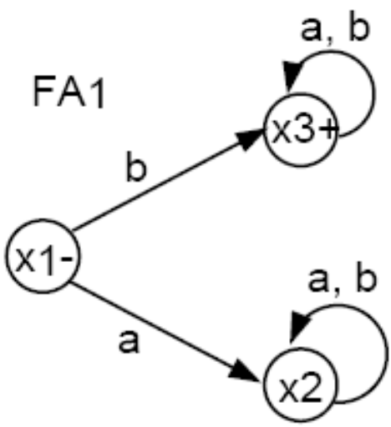
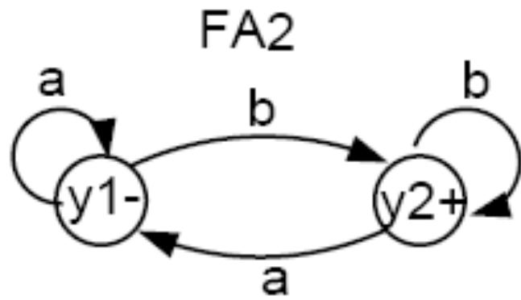
Example
FA₁ accepts all words that start with a b.
FA₂ accepts all words that end with a b.
We will use the above algorithm to construct FA₃ that accepts the product of the languages of FA₁ and FA₂, respectively. That is, FA₃ will accept all words that both start and end with the letter b.
Theory of Automata

Slide 52
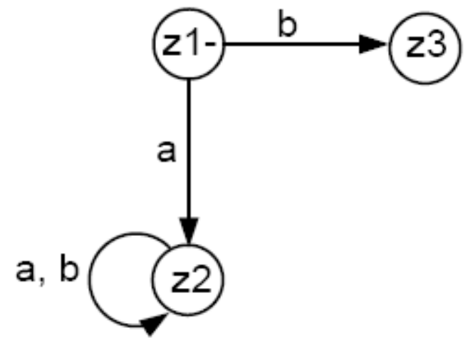
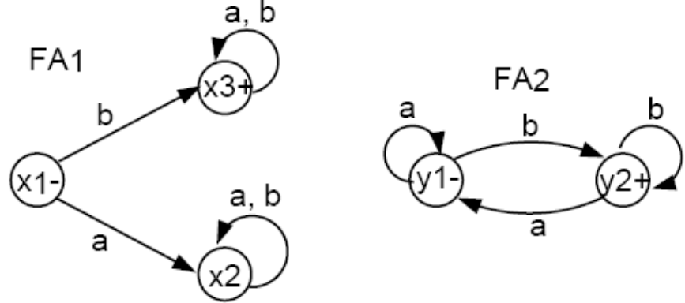
Initially, we must begin with x₁ = z₁.
In z₁, if we read an a, we go to x₂ = z₂.
In z₁, if we read a b, we go to x₃, a final state, which gives us the option to jump to y₁. Hence, we label z₃ = x₃ or y₁.
From z₂ just like x₂, both an a or a b take us back to z₂, i.e., we have a loop here.
Theory of Automata

Slide 53
In z3, if we read an a then the following happens. If z3 is x3, we can stay in x3 or jump to y1 (because x3 is a final state). If z3 is y1, we would loop back to y1. In any of the events, we end up at either x3 or y1, which is still z3. Hence, we have an a-loop at z3.
In z3, if we read a b, then a different event takes place. If z3 is x3 we either stay in x3 or jump to y1. If z3 is y1, then we go to y2, a final state. Hence, we need a new final state z4 = x3 or y1 or y2.
In z4, if we read an a, what happens? If z4 is x3 then we go back to x3 or jump to y1. If z4 is y1 then we loop back to y1. If z4 is y2, we go to y1. Thus, from z4, an a takes us to x3 or y1, which is z3.
In z4, if we read a b, what happens? If z4 is x3, we go back to x3 or jump to y1. If z4 is y1, we go to y2, a final state. If z4 is y2, we loop back to y2, a final state. Hence, from z4 a b takes us to x3 or y1 or y2, which is still z4 (i.e., we have a b-loop here).
Theory of Automata

Slide 54
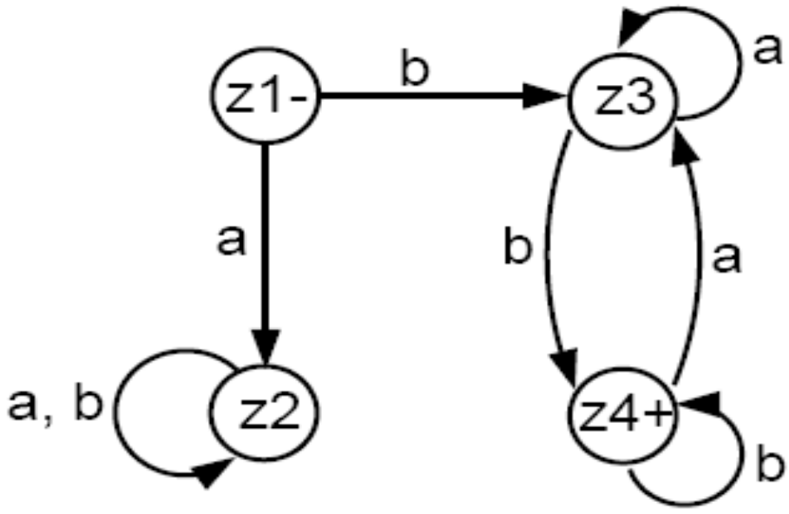
xW
This machine accepts all words that both begin and end with the letter b, which is what the product of the two languages (defined by FA₁ and FA₂ respectively) would be.
If you multiply the two languages in opposite order (i.e. first FA₂ then FA₁), then the product language will be different. What is that language? Can you build a machine for that product language
Theory of Automata

Slide 55
NFA - Non-Deterministic Finite Automata

Slide 56
NFA
Definition: An NFA is a TG with a unique start state and with the property that each of its edge labels is a single alphabet letter.
The regular deterministic finite automata are referred to as DFAs, to distinguish them from NFAs.
As a TG, an NFA can have arbitrarily many a-edges and arbitrarily many b-edges coming out of each state.
An input string is accepted by an NFA if there exists any possible path from - to +.
Theory of Automata

Slide 57
NFA
An NFA is quintuple M={Q,Σ,q₀, F, δ}
  Q is set of finite states
  Σ is a finite set of symbols called alphabet
  q₀ belongs to Q is distinguished Start State
  F is subset of Q called the Final or Accepting states
  δ is a total function from Q x Σ to P(Q) known as transition function, such that, an input symbol may cause more than one next states, i.e., to one state out of a set of possible next states.
  P(Q) is the power set of Q, that is, 2^{Q}
Theory of Automata

Slide 58
NFA
Definition: A nondeterministic finite automaton (or NFA) is a TG with a unique start state and with the property that each of its edge labels is a single alphabet letter.
The regular deterministic finite automata are referred to as DFAs, to distinguish them from NFAs.
As a TG, an NFA can have arbitrarily many a-edges and arbitrarily many b-edges coming out of each state.
An input string is accepted by an NFA if there exists any possible path from - to +.
Theory of Automata

Slide 59
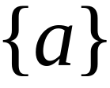


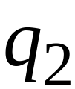


Nondeterministic Finite Accepter (NFA)
Alphabet =
Theory of Automata

Slide 60
Nondeterministic Finite Accepter (NFA)
Alphabet =
Two choices
Theory of Automata

Slide 61
Nondeterministic Finite Accepter (NFA)
Alphabet =
Two choices
No transition
No transition
Theory of Automata

Slide 62
First Choice
Theory of Automata

Slide 63
First Choice
Theory of Automata

Slide 64
First Choice
Theory of Automata

Slide 65
First Choice
“accept”
Theory of Automata

Slide 66
Second Choice
Theory of Automata

Slide 67
Second Choice
Theory of Automata

Slide 68
Second Choice
No transition:
the automaton hangs
Theory of Automata

Slide 69
Second Choice
“reject”
Theory of Automata

Slide 70
Observation
An NFA accepts a string:
If there is a computation of the NFA
that accepts the string
Theory of Automata

Slide 71

Example
is accepted by the NFA:
Theory of Automata

Slide 72

Lambda Transitions
Theory of Automata

Slide 73
Theory of Automata

Slide 74
Theory of Automata

Slide 75
(read head doesn’t move)
Theory of Automata

Slide 76
Theory of Automata

Slide 77
“accept”
String is accepted
Theory of Automata

Slide 78
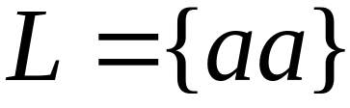
Language accepted:
Theory of Automata

Slide 79
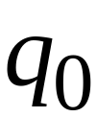


Another NFA Example
Theory of Automata

Slide 80

Theory of Automata

Slide 81
Theory of Automata

Slide 82
Theory of Automata

Slide 83
“accept”
Theory of Automata

Slide 84
Another String
Theory of Automata

Slide 85
Theory of Automata

Slide 86
Theory of Automata

Slide 87
Theory of Automata

Slide 88
Theory of Automata

Slide 89
Theory of Automata

Slide 90
Theory of Automata

Slide 91
“accept”
Theory of Automata

Slide 92
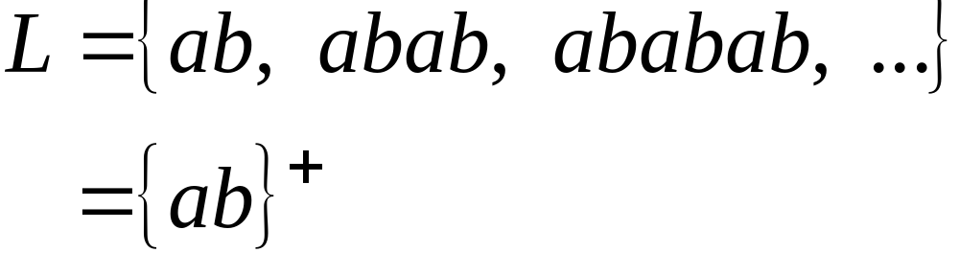
Language accepted
Theory of Automata

Slide 93

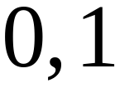

Another NFA Example
Theory of Automata

Slide 94
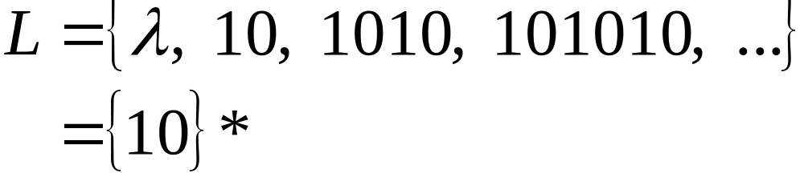
Language accepted
Theory of Automata

Slide 95









Theory of Automata

Slide 96
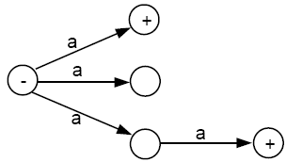
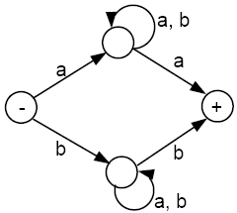
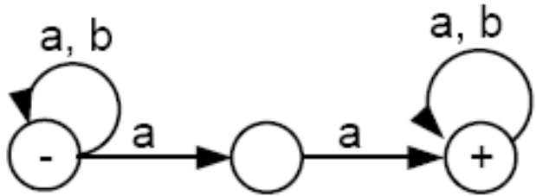
Examples of NFAs
Theory of Automata

Slide 97
Theorem 7
for every NFA, there is some FA that accepts exactly the same language.
Proof 1
By the proof of part 2 of Kleene’s theorem, we can convert an NFA into a regular expression, since an NFA is a TG.
By the proof of part 3 of Kleene’s theorem, we can construct an FA that accepts the same language as the regular expression. Hence, for every NFA, there is a corresponding FA.
Theory of Automata

Slide 98
Distinguished Features
FA/DFA
One start state ONLY & Zero or more Final States
NFA
One start state ONLY & Zero or More Final States
Null transitions
Non-determinism
TG
One or More Start States
Zero or More Final States
Multiple letters on the edges
Null transitions
Non-determinism
Theory of Automata

